Slide 1
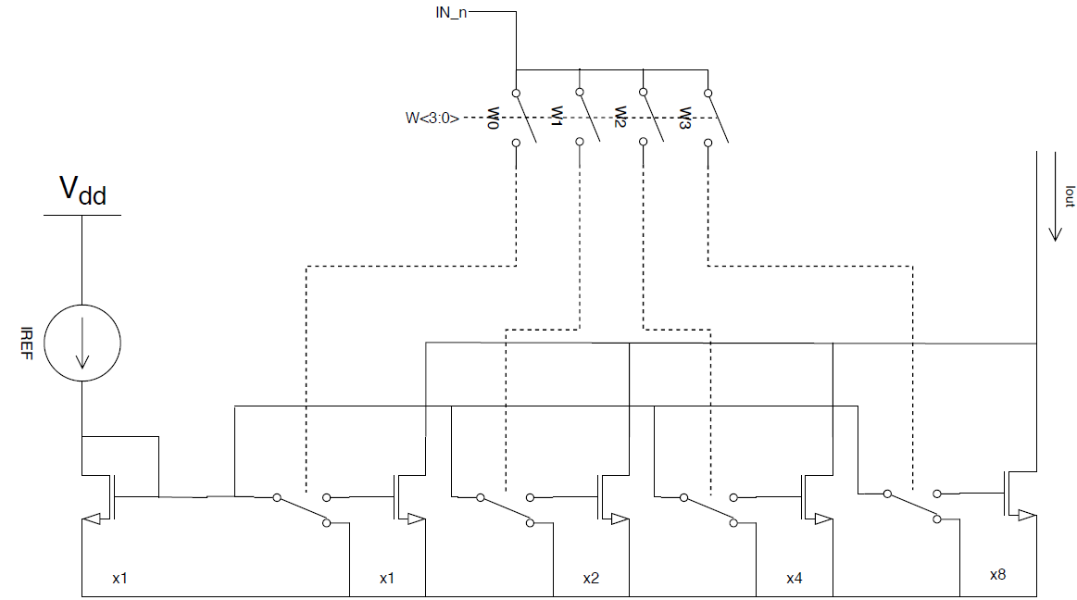
NMOS mirror

Slide 2
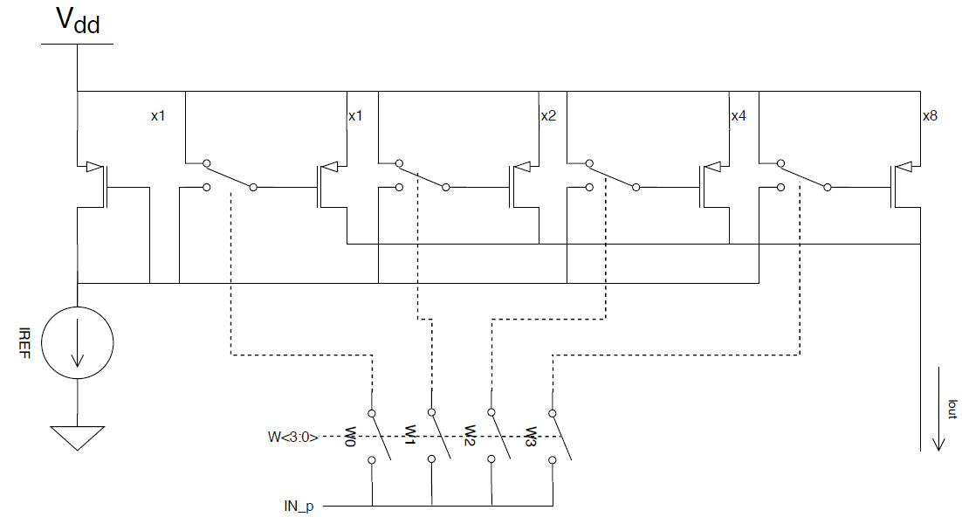
PMOS Mirror

Slide 3
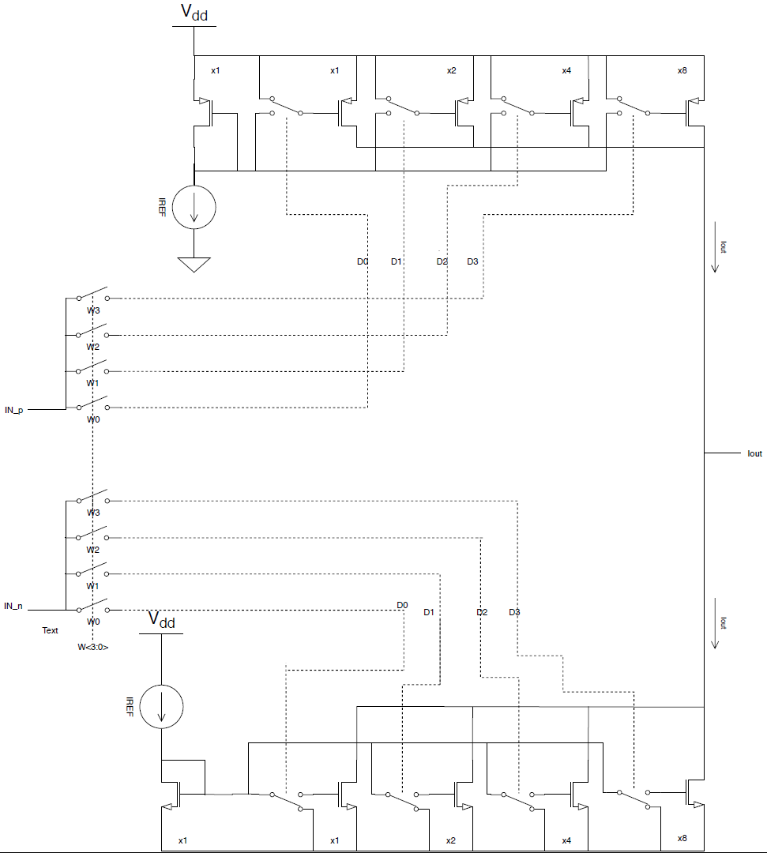
1 input neuron

Slide 4
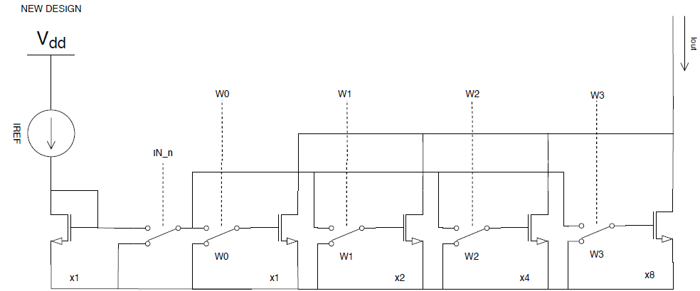
NMOS simplified (new)

Slide 5
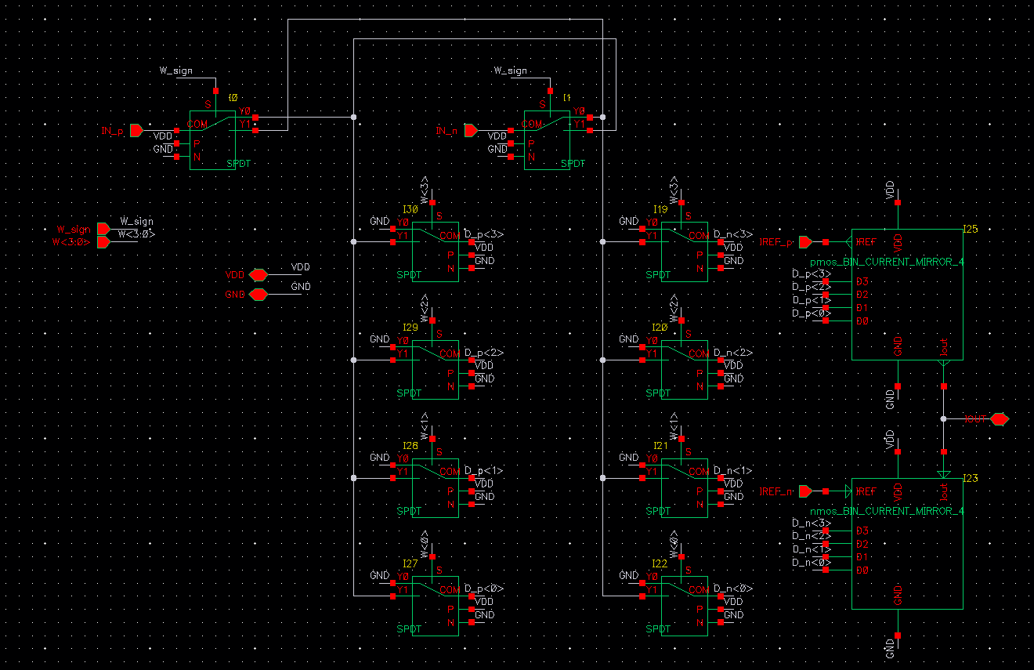
1 input neuron cadance

Slide 6
